Slide 1
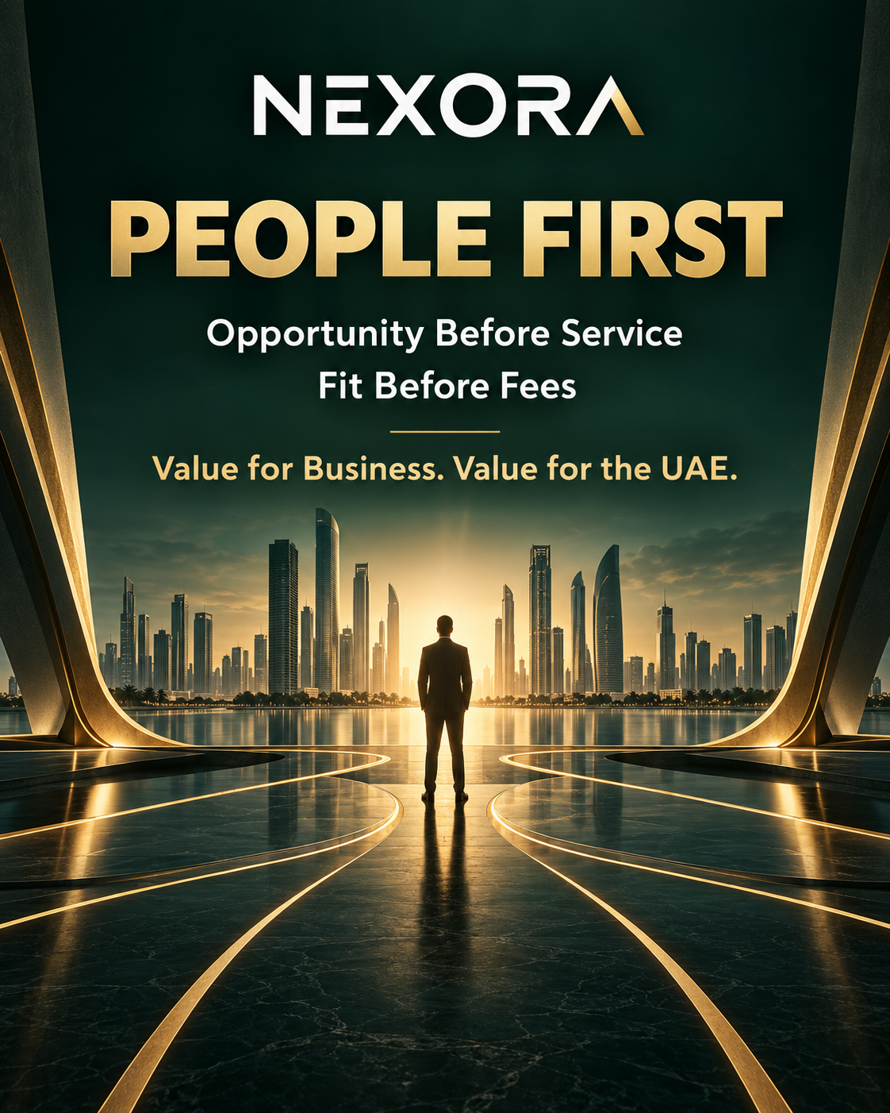
nexoramatch.com

Slide 2
Why NEXORA?
An Emirati-led business platform that starts with genuine need
We show what fits the person and the business, not what pays the highest commission.
01
02
03
Market understanding
Clearer decisions
Shared value
Knowledge of UAE opportunities, setup pathways and investment context.
Direct sources and relevant alternatives before fees are paid.
Collaboration that benefits both parties and adds value to the UAE.

Slide 3
Vision and mission
From the UAE to global markets
01
02
Our vision
Our mission
To become trusted business infrastructure that connects people and companies with relevant opportunities, organisations and relationships, starting in the UAE and expanding globally.
To combine market knowledge, strategic planning, foresight and AI so companies can discover opportunities, assess fit and reach the right next step.
People come first in every decision.

Slide 4
How NEXORA works
Connecting digital intelligence with live human knowledge
01
02
03
Digital intelligence
Human knowledge
Immediate action
AI analyses available sources, opportunities and market information. The platform improves as AI capabilities advance.
Users contribute real needs and information that public sources cannot provide, at the time and place of interaction.
The platform turns exchanged information into a match and a practical next step between people or companies.
Matching starts without a mandatory account, keeping the experience fast at events and meetings.

Slide 5
A multi-market network
Starting in the UAE and designed to work across countries and sectors
01
02
03
Events and opportunities
Global application
Network continuity
NEXORA connects in-person meetings with UAE opportunities and structured follow-up after each event.
The model can operate between companies and markets, extending UAE opportunities and expertise internationally.
Diverse countries and sectors allow activity to shift toward other markets and pathways as conditions change.
Mohamed Al Mazrouei develops the platform through direct engagement and first-hand understanding of company needs.

Slide 6
Our values
Principles that shape platform decisions
01
02
03
04
People first
Transparency
Fair recommendations
Responsible innovation
Human interest and informed decisions before commercial goals.
Clear sources, fees, commissions and paid relationships.
Fit determines results, not paid placement.
AI supports human judgement.
Credibility, privacy and value for the UAE remain constant.

Slide 7
Our goals
Platform growth tied to measurable value
1. Make UAE opportunities easier to access for local and global companies.
2. Help organisations reach better matched companies.
3. Enable clearer decisions before fees are paid.
4. Connect opportunities, companies, relationships, smart cards and events.
5. Raise transparency standards in business and setup services.
6. Turn future changes into actionable opportunities.
7. Expand globally while preserving the same principles.

Slide 8
Partnership standard
Cooperation based on genuine need and clear terms
1. Put people and genuine need before sales.
2. Disclose services, prices and commissions clearly.
3. Do not sell unnecessary services.
4. Do not claim government affiliation or guaranteed approval.
5. Show official sources and direct alternatives.
6. Do not buy higher placement in NEXORA recommendations.
7. Protect user data and measure success through value delivered.

Slide 9
NEXORA
Tools can be copied.
A system built from day one to put people first and create value for the UAE is harder to copy.
Explore our vision at nexoramatch.com

